Slide 1
RELIEF CLASSIFICATION BY TOPOGRAPIC POSITION INDEX
CHUKWU CHINYERE PRECIOUS

Slide 2
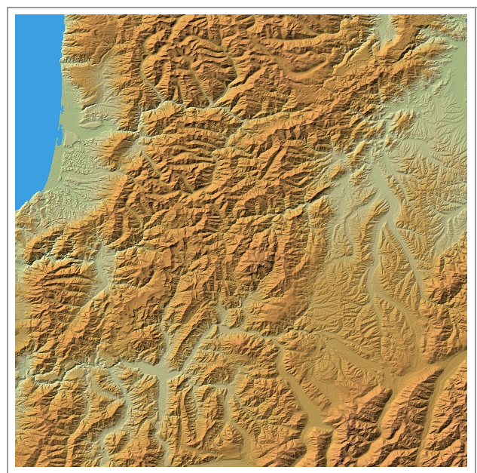
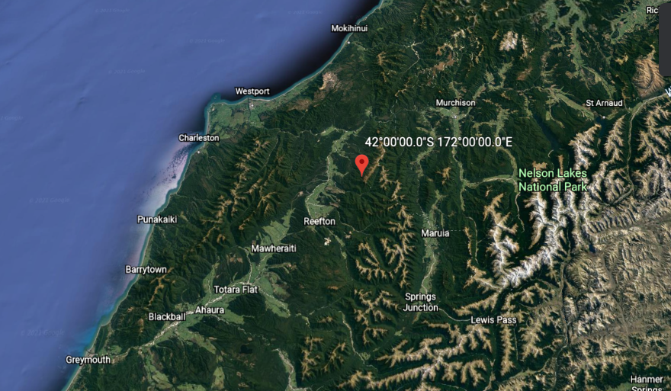
DATA SOURCE : AW3D30 MODEL
LOCATION: NEW ZEALAND: NELSON LAKES NATIONAL PARK
COORDINATE: S042E172
LOCATION ON AW3D30MODEL
LOCATION ON GOOGLE EARTH IMAGERY

Slide 3
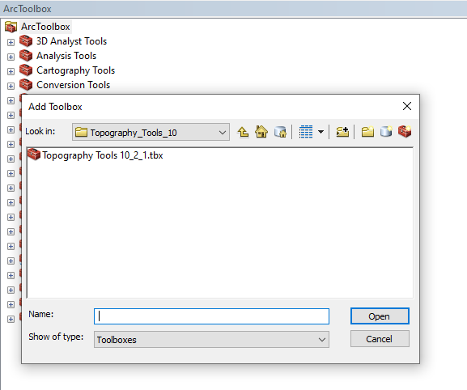
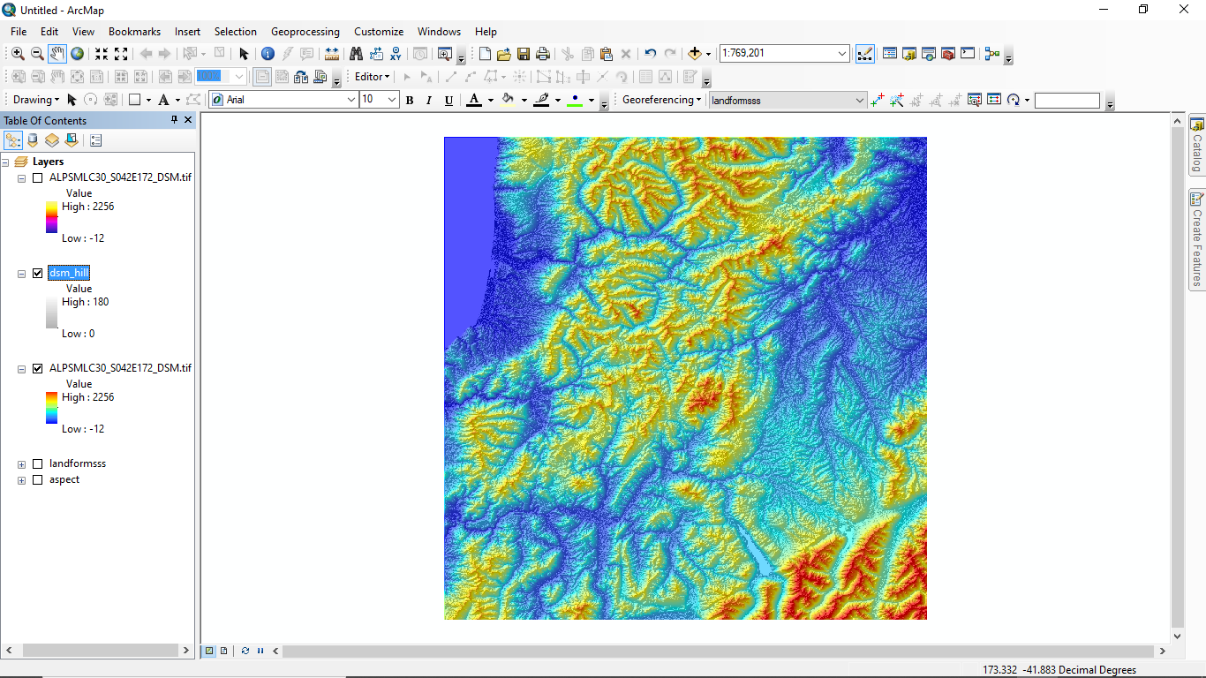
SHADED RELIEF WITH DSM
ADDING TOOLBOX:

Slide 4
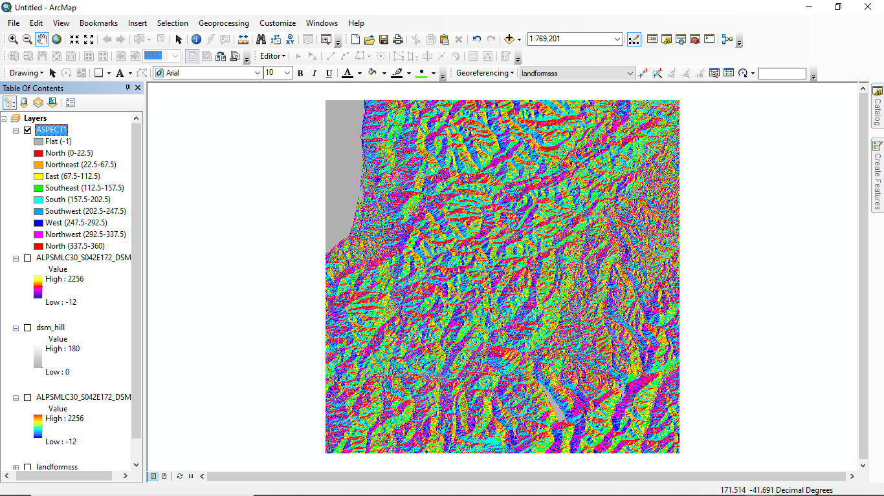
DSM_ASPECT_MAP

Slide 5
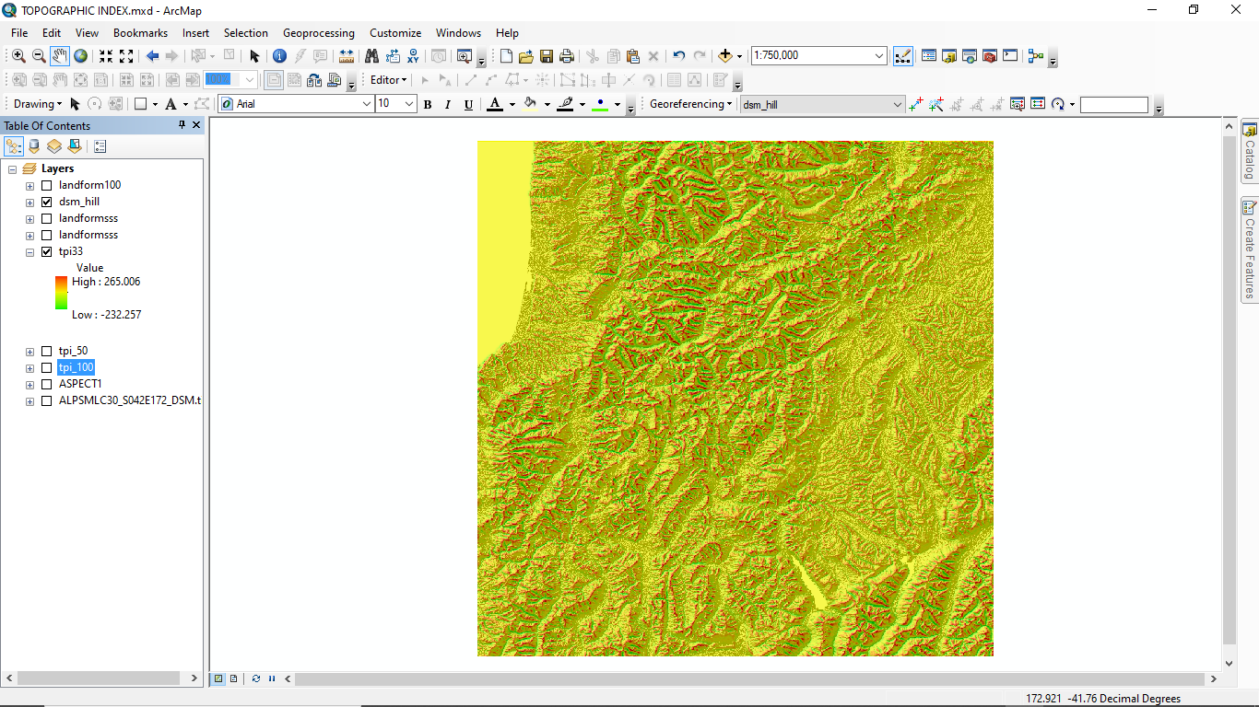
TOPOGRAPHIC POSITION INDEX_33

Slide 6
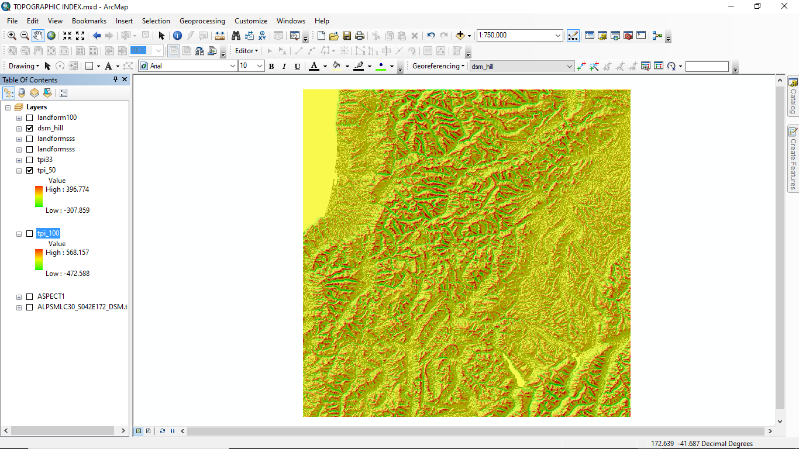
TOPOGRAPHIC POSITION INDEX_50

Slide 7

TOPOGRAPHIC POSITION INDEX_100

Slide 8
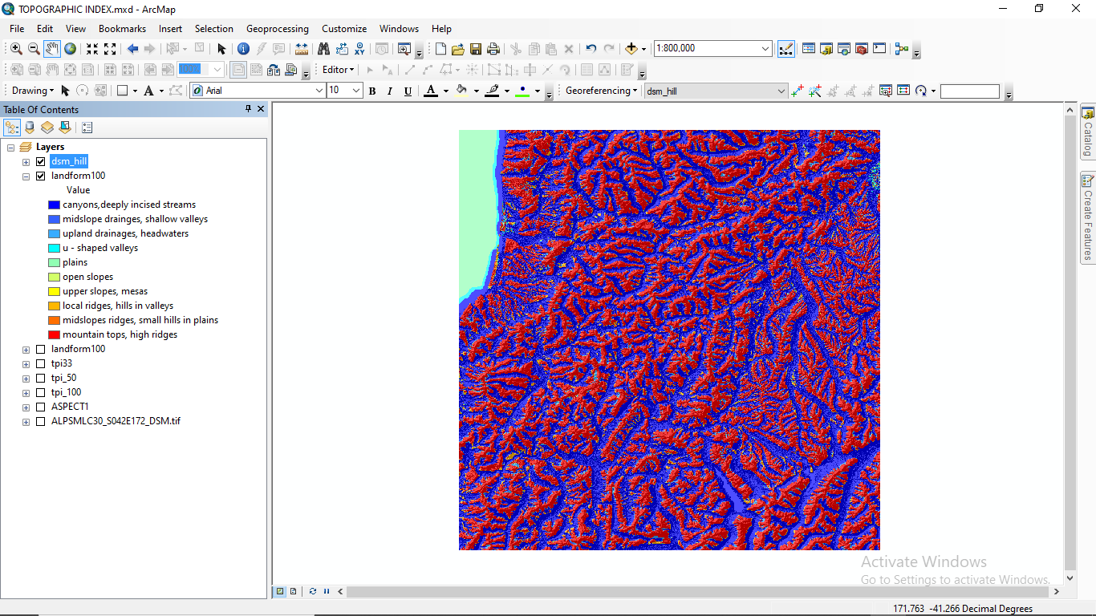
LANDFORM CLASSIFICATION

Slide 9
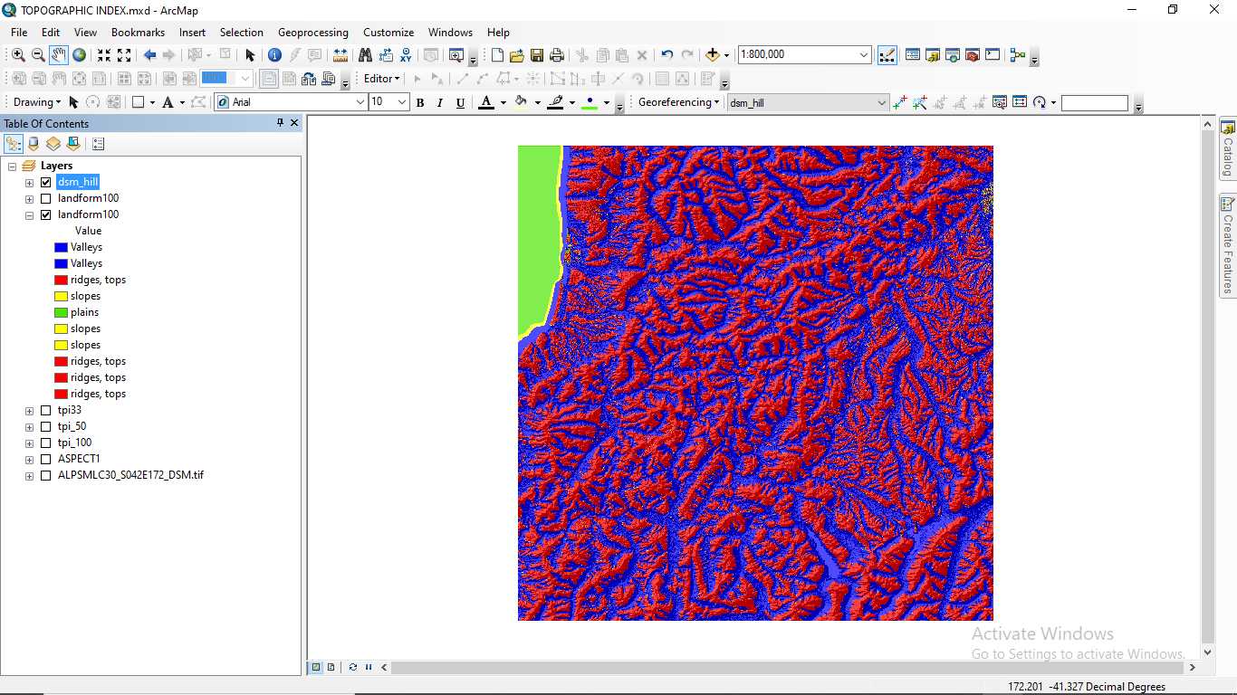
LANDFORM CLASSIFICATION (4 CLASSES)

Slide 10
AREA CALCULATION OF LANDFORM IN (%)
Land form | Number of Cells | Percentage(%)
Canyons, deeply incise stream | 611 843 7 | 47,26
Midslope drainages, shallow valleys | 342 45 | 0,26
Upland drainages, headwaters | 463 295 | 3,58
U-shaped valleys | 976 57 | 0,75
Plains | 402 340 | 3,11
Open slopes | 3060 | 0,02
Upper slopes, mesas | 433 54 | 0,33
Local ridges, hills in valleys | 451 154 | 3,48
Midslope ridges, small hills in plains | 432 85 | 0,33
Mountain tops, high ridges | 528 887 777 | 40,85

Slide 11
AREA CALCULATION OF 4 LANDFORM CLASSES IN (%)
Land form | Number of Cells | Percentage(%)
Valleys | 6 152 682 | 47,53
Plains | 402 340 | 3,11
Slopes | 144 071 | 1,11
Ridges & Tops | 6 246 511 | 48,25
TOTAL | 12 945 6 04 | 100

